Slide 1

Notes:
I’m Tony Najjar and with me is my partner Walid Abou Lhosn. Today we are proudly presenting Steady. Steady is a good self-balancing friend we created for the purpose of the Mechatronics project 1 course.

Slide 2
Outline
Introduction
Goals
Background Research
Working Principle
Technical Discussion
CAD
Wiring and Powering
Modeling & Simulation
Control System
Kalman Filter
Future Enhancements
Notes:
We will start off by a quick introduction on self-balancing robots in general. We will then move on to some background research we did in order to fully understanding the working principle of self balancing robots and the laws of motion they follow.

Slide 3
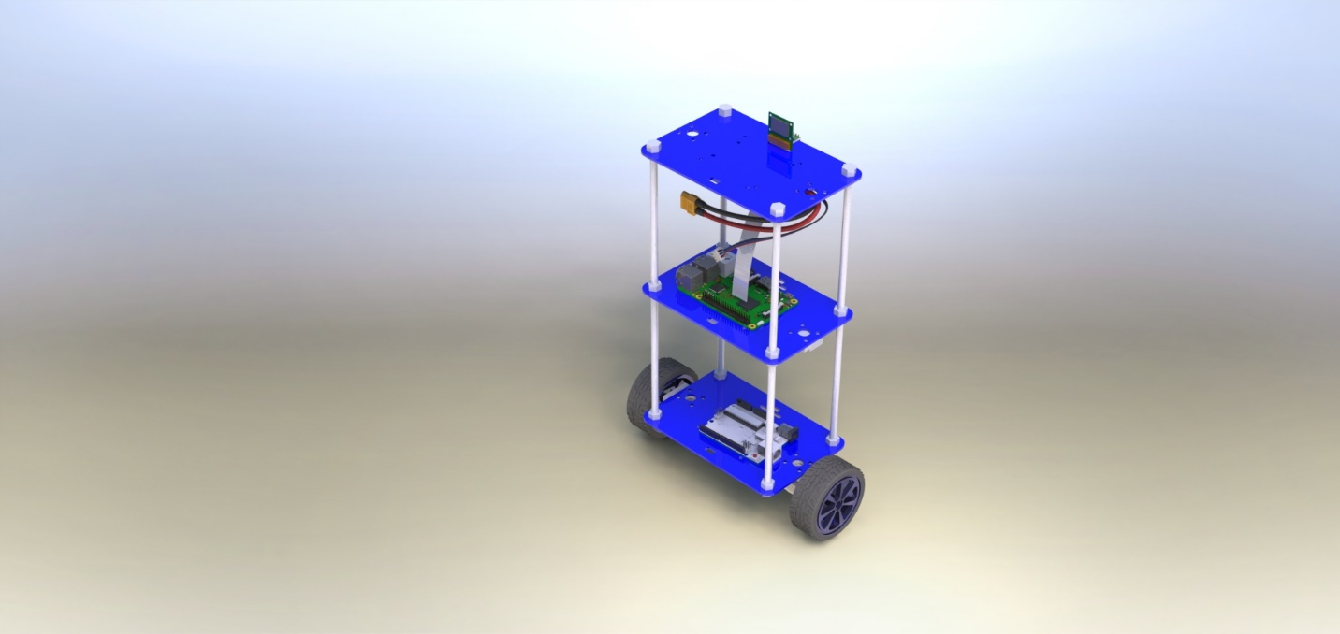
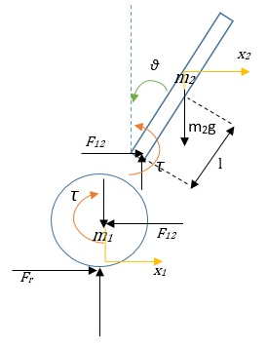
Introduction
A self-balancing robot is essentially an inverted pendulum on wheels

Slide 4
Goals
To design, construct and program a self-balancing robot, the following objectives have been set:
Design and assemble the chassis of the robot
Mount all the electronic hardware on the chassis and make all the electrical connections
Develop the software to read from the sensors and to control the actuators
Implement a PID controller to enable the robot to stay upright
Add a cascaded PID controller to control robot’s position
Develop the software for wireless control and camera streaming

Slide 5
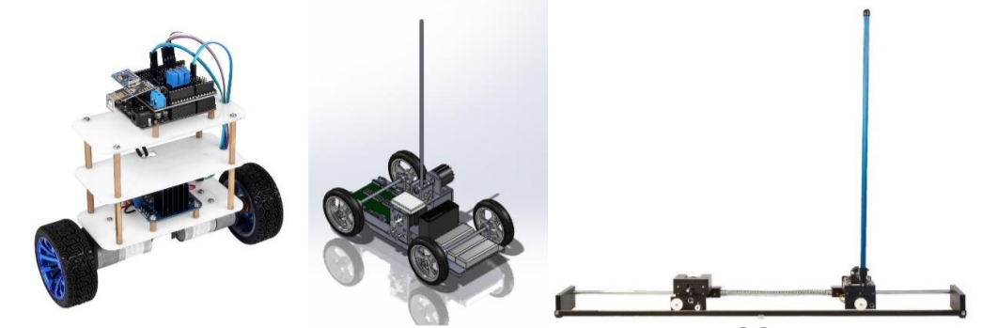
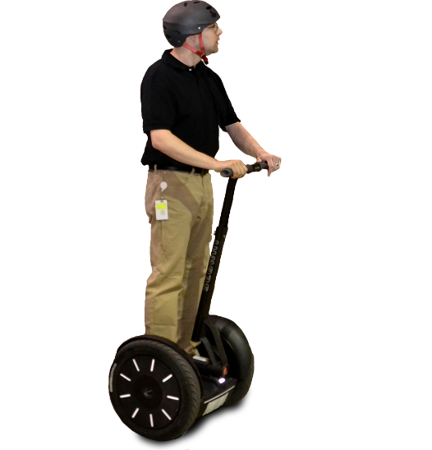
Background Research
The most common types of inverted pendulums are the self-balancing robot, inverted pendulum on a cart and an inverted pendulum on a linear track
Notes:
The inverted pendulum is a classical problem in control systems, and to explore the unstable dynamics, different platforms have been developed. These platforms are similar in many ways, leading to many of the behaviors being comparable. The most common types are the self-balancing robot, Inverted Pendulum on a cart and an inverted pendulum on a linear track

Slide 6
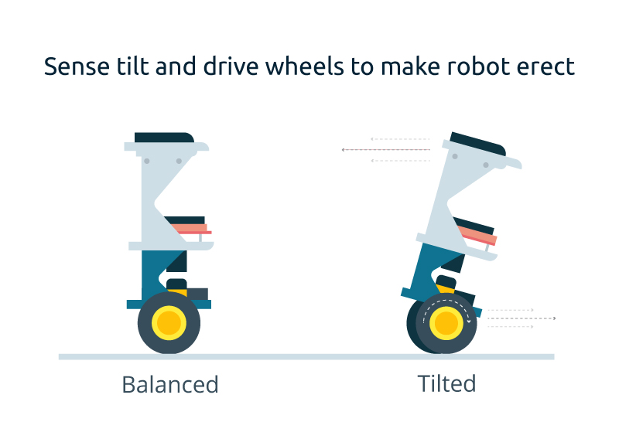
Working Principle
Notes:
When the operator leans forward, the wheels turn in unison in the same direction to provide forward motion. In order to stop, the wheels must accelerate forward to get out in front of the system's center of mass and then apply a deceleration torque to slow the system down without causing the operator to fall forward of the device. These operating principles are reversed to allow the system to move backward. In order to turn, the wheels rotate at unequal speeds causing the system to travel in an arc. If the system is not translating forward or backward, then the wheels can rotate in opposite directions to turn the machine in place.

Slide 7

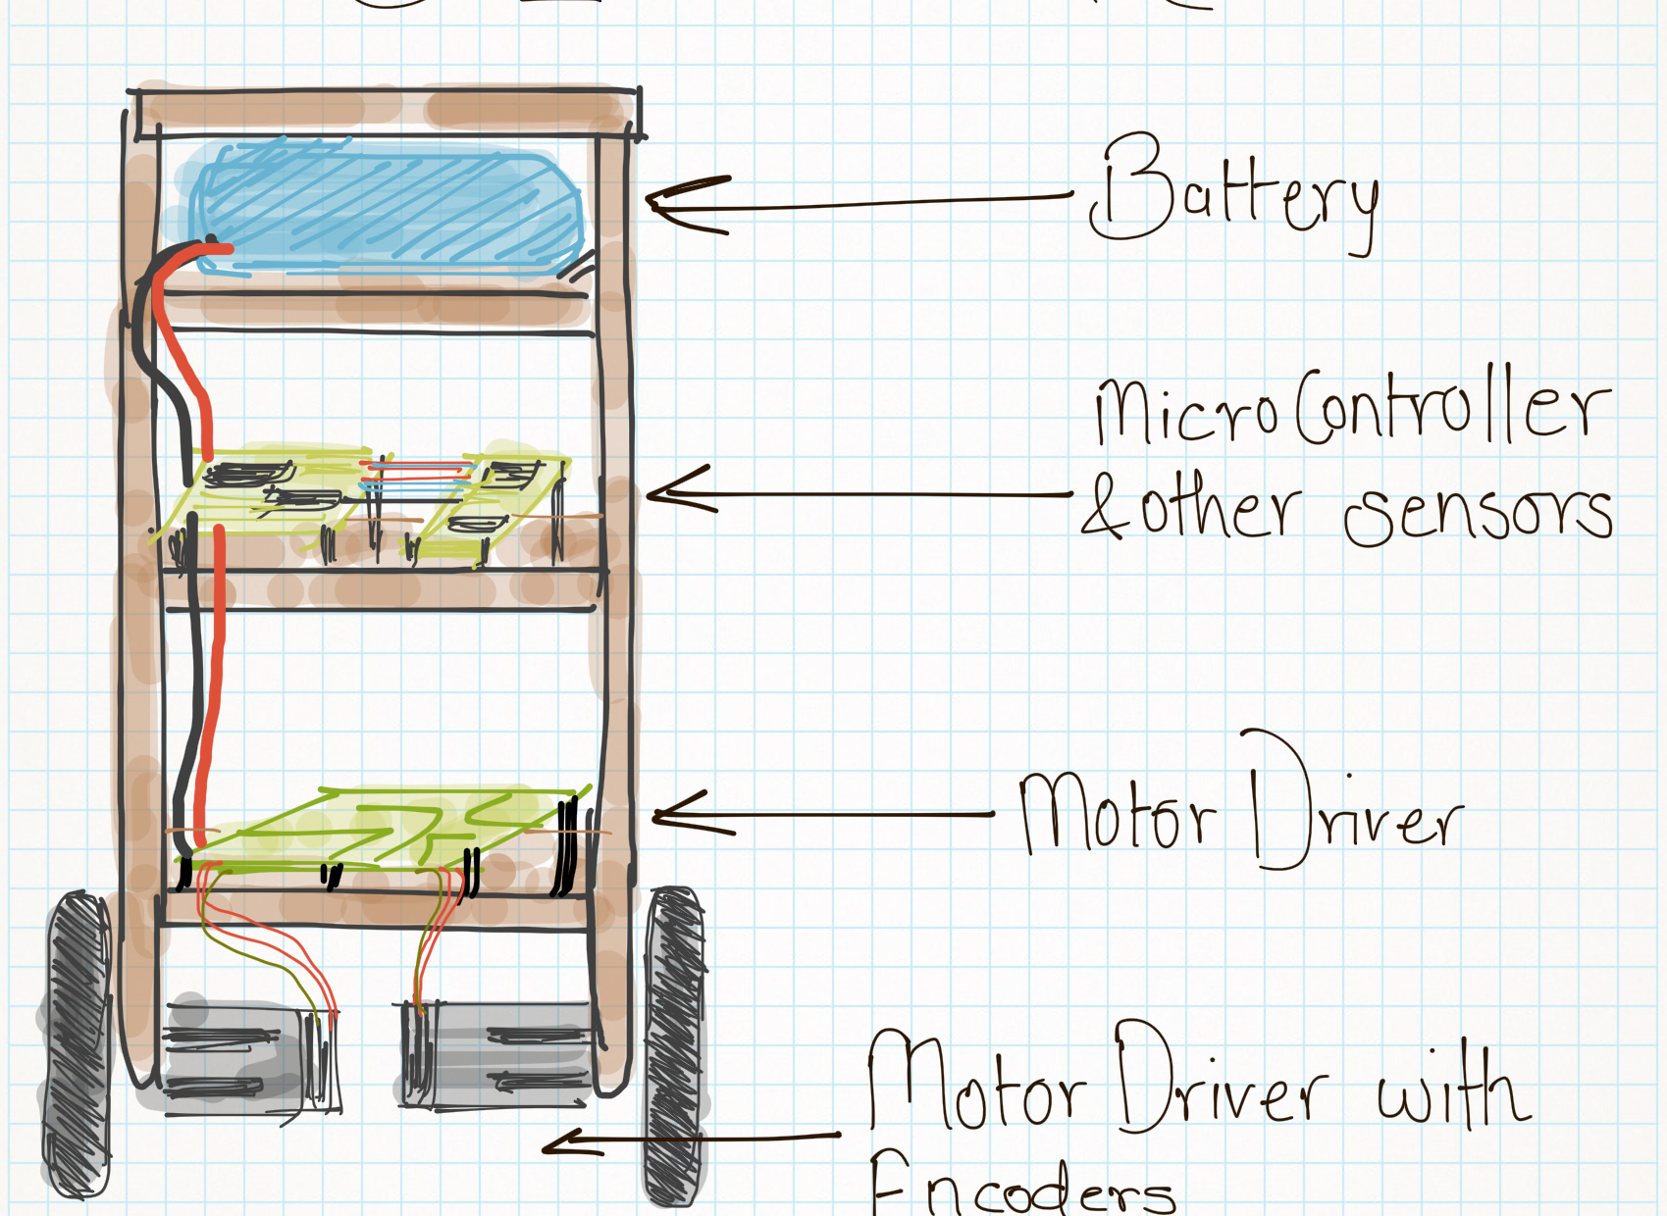

CAD & Manufacturing
Arduino
Raspberry Pi + Camera
MPU6050
Motor Driver
Step-down DC Transformer
Battery
Geared motors with encoders
Notes:
What did we take into consideration when manufacturing eg. EMI form motors on IMU, the taller the easier to control, wheel dimensions

Slide 9
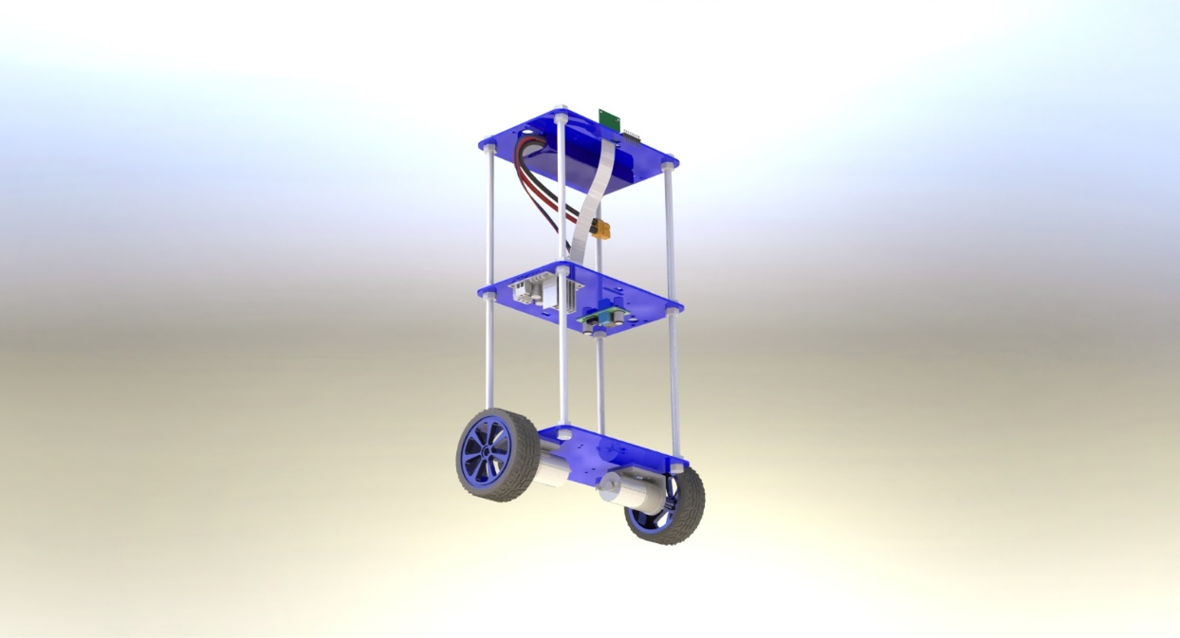

Slide 10
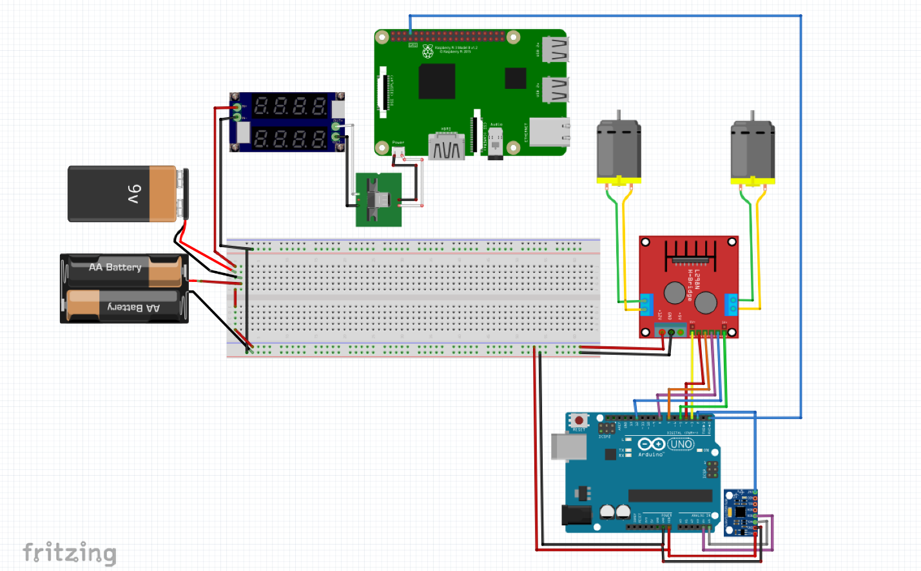
Powering & Wiring
Main power supply: 12V
DC transformer for Raspberry Pi (5V)
Arduino regulator output for MPU6050 (3.3V)

Slide 11
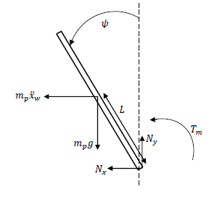
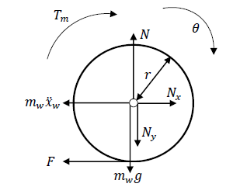
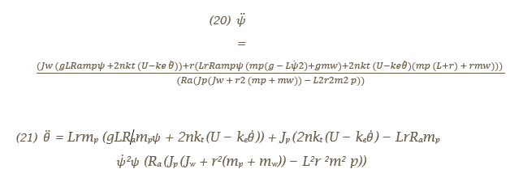
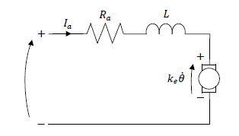
Modeling

Slide 12
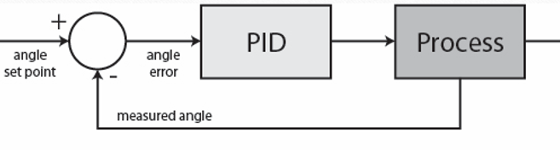
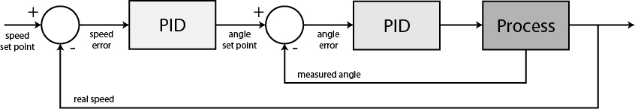
Control System
position
position
position
From IMU
From Encoders

Slide 13
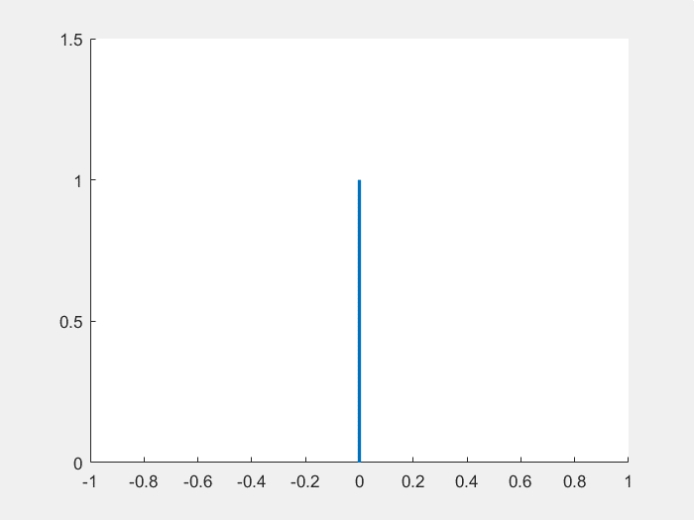
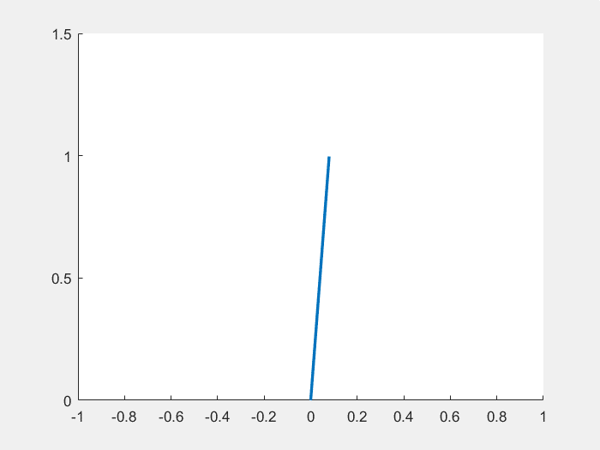
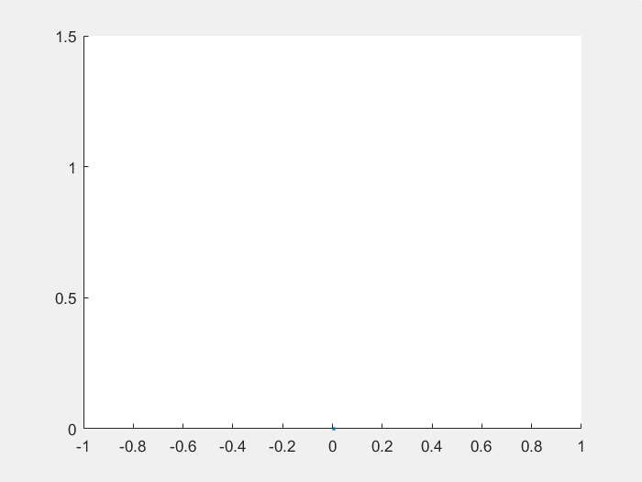


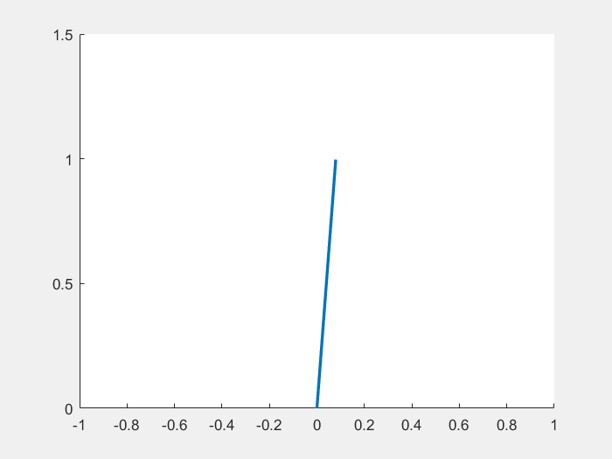
Simulation
Unstable
Underdamped
Critically Damped

Slide 14
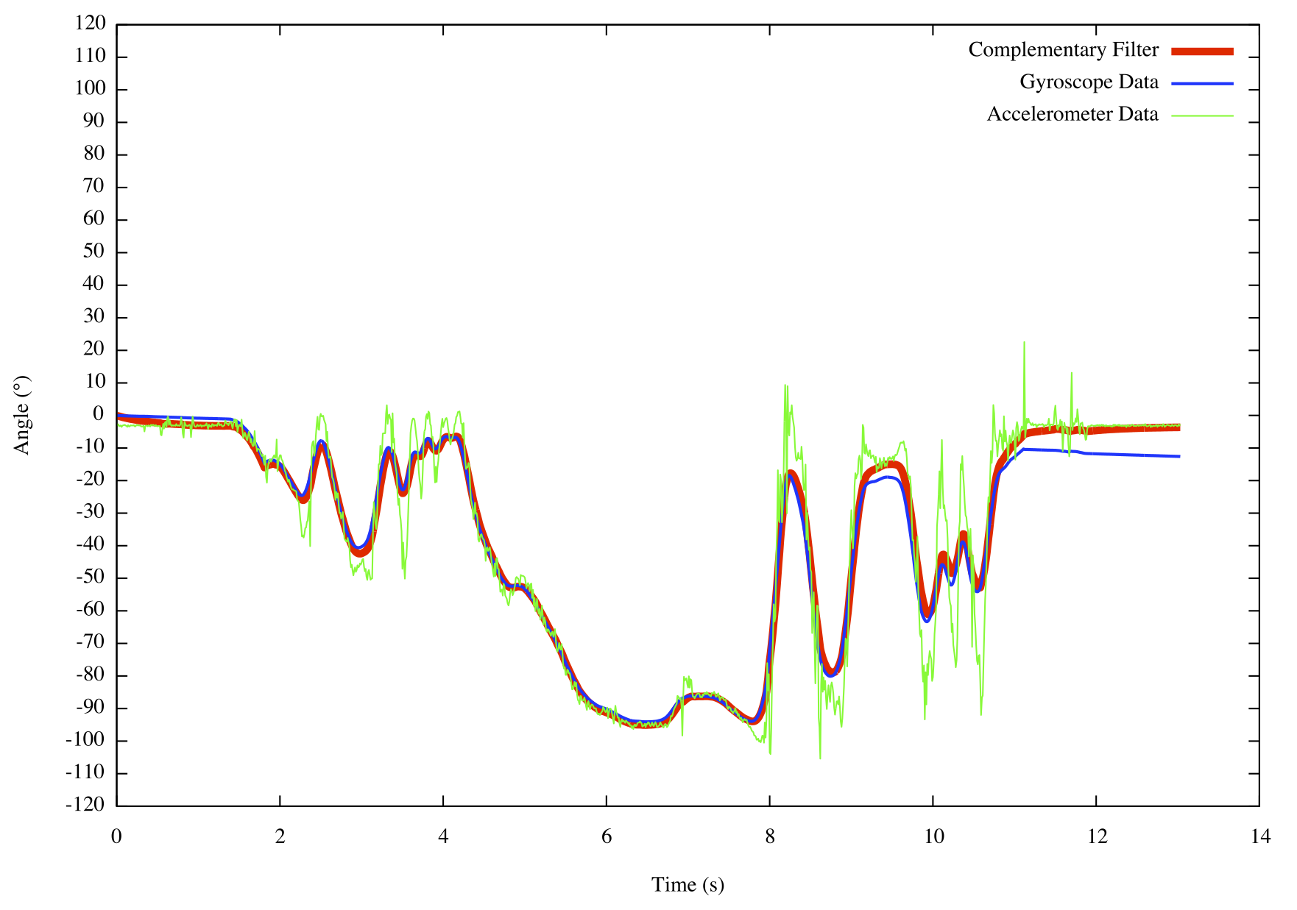
Kalman Filter
Out of the scope of this presentation but here’s a quick explanation

Slide 15
Future Enhancements
Smoothening the controllers for better transient response
Adding: computer vision (to follow a ball for example)
Adding ultrasonic sensors for table/stair edge detection
Adding side arms for fall cushioning and automatic stand up.

Slide 16
Results
Time for the Demo!

Slide 17


